Slide 1
Jesus is the Answer Pastor George Saieg www.MinistryToMuslims.com

Slide 2
The Importance of
Apologetics & Polemics
for Evangelism Among Muslims

Slide 3
Christianity Compared to Islam
The Garden God The Best Deceiver Incarnation Spiritual World Humanity Prayer Mission Atonement Unforgivable Sin Heaven | Christianity Genesis 3:8-9 Trinity Satan (John 8:44) God becomes man Holy Spirit Can become Children of God Two Way Matthew 28:19-20 Through the Work of Jesus To Reject the Work of Jesus With our Lord and Savior forever | Islam Allah was NOT in the Garden Tawheed Allah (K. 3:54) Allah cannot become man Jinns Slave of Allah One Way The Islamic State A Jew & a Christian To accept Jesus as Lord Allah will NOT be in heaven

Slide 4
One familiar response from Muslims when Christians witness to them is, “We believe in Jesus.” Are they referring to the Jesus of the Bible? Did he die on the cross? And, is he the Savior of the World?

Slide 5
Who is the Jesus of the Koran?
The Similarities and Differences Between Jesus and Isa

Slide 6
The Similarities Between Jesus and Isa

Slide 7
Jesus Was Born of a Virgin:
Koran Says
“How can I have a son when no man has touched me…?” K. 19:20
Bible Says
“…a virgin shall conceive, and bear a son, and shall call his name Immanuel” Isaiah 7:14 (700 BC)

Slide 8
Keep in mind:
The Koran teaches that Mary had son without a husband but the Koran also teaches that Allah can’t have a son without a wife: “… how can He have a son, when He (Allah) has no female companion…?” (K. 6:101)
We should ask: Was Mary more powerful than Allah?

Slide 9
Jesus was Conceived by the Holy Spirit:
Koran Says
… we breathed into her of our Spirit, and we made her and her son a sign unto the worlds.
– K. 21:91
Bible Says
… The Holy Ghost shall come upon thee, and the power of the Highest shall overshadow thee: therefore also that holy thing which shall be born of thee shall be called the Son of God. - Luke 1:35

Slide 10
Keep in mind:
The Koran using “We” for Allah, Muslims scholars says: “It is the We of Majesty”
We should ask: , If Allah is the greatest being, shouldn't the Quran use the “I” of majesty?

Slide 11
Jesus is a Servant & Prophet:
Koran Says
… I am a servant of Allah; He has brought me the Book, and He has made me a prophet, - K. 19:30
Bible Says
Behold, my servant shall deal prudently, he shall be exalted and extolled, and be very high. Isaiah 52:13 (700 years before Christ)
… This is of a truth that prophet that should come into the world. John 6:14 – Also see: Luke 24:19

Slide 12
Jesus is the Word of God:
Koran Says
… Jesus the son of Mary, is but the apostle of Allah and His Word… – K. 4:171
Bible Says
And the Word was made flesh, and dwelt among us... John 1:14

Slide 13
Keep in mind:
Islam Teaches that: Allah’s word (Koran) is eternal: “Nay, it is a glorious Koran in a preserved tablet.” (K. 85:21-22)
Mohammad said Allah’s word going to become a man: "The Koran is coming on the Resurrection day, as light skin (White) man, and say: 'I am the one that kept your night long and made you thirsty during the day." (Sunan Ibn Majah 3781)
Allah created the world by his word: “His bidding is only, when He desires anything to say to it, 'BE,' and it is.” (K. 36:82)

Slide 14
Jesus is the Christ (The Messiah):
Koran Says
… The Messiah, Jesus the son of Mary… – K. 4:171
Bible Says
… We have found the Messiah, which is, being interpreted, the Christ. – John 1:41

Slide 15
Keep in mind:
Islam teaches that the Koran was revealed in 23 years. 13 years in Mecca and 10 years in Medina. The Koran never used “Messiah” for Jesus till Mohammad moved to Medina.

Slide 16
Jesus is Sinless:
Koran Says
Said he (The Angel), 'I am only a messenger of thy Lord to bestow on thee (Marry) a sinless son (Jesus)' – K. 19:19
Bible Says
For he hath made him to be sin for us, who knew no sin... - 2 Corinthians 5:21

Slide 17
Keep in mind:
Abu Huraira said, "I heard Allah's Messenger saying, “There is none born among the off-spring of Adam, but Satan touches it…except Mary and her child.” Sahih al-Bukhari 3431 Book 60, Hadith 102
Know thou (Mohammad) that there is no god but Allah; and ask pardon for thy sin and for the believers, men and women; for Allah knows your return and your resort! K. 47:19

Slide 18
Jesus is With God:
Koran Says
When God said, 'O Jesus! I will make Thee die and take Thee up again to me .... - K. 3:55
Bible Says
…looked up steadfastly into heaven, and saw the glory of God, and Jesus standing on the right hand of God, - Acts 7:55

Slide 19
Jesus is the Judge:
Koran Says
And, verily, he is a sign of the Hour… K. 43:61 … the Messenger of Allah said that `Isa will descend before the Day of Resurrection as a just ruler and fair judge. - Ibn Kathir commentary K. 43:61
Bible Says
For we must all appear before the judgment seat of Christ; that every one may receive the things done in his body, according to that he hath done, whether it be good or bad. - 2 Corinthians 5:10

Slide 20
Keep in mind:
Say, ‘Allah knows best of their tarrying. His are the unseen things of the heavens and the earth – He can see! and hear!’ They have no patron beside Him, nor does He let any one share in His judgment. K. 18:26

Slide 21
The Differences Between
Jesus and Isa

Slide 22
Is Jesus More than a Prophet?
Koran Says
The Messiah the son of Mary is only a prophet: prophets before him have passed away; and his mother was a confessor; they used both to eat food. - See how we explain to them the signs, yet see how they turn aside! – K. 5:75
Bible Says
For unto us a child is born, unto us a son is given: and the government shall be upon his shoulder: and his name shall be called Wonderful, Counsellor, The mighty God, The everlasting Father, The Prince of Peace. – Isaiah 9:6

Slide 23
Is Jesus More than a Prophet?
If Jesus is only a Prophet he is not good enough to die for us! “But these are written, that ye might believe that Jesus is the Christ, the Son of God; and that believing ye might have life through His name.” John 20:31

Slide 24
Is Jesus the Creator?
Koran Says
"Lo! the likeness of Jesus with Allah is as the likeness of Adam, He created him from dust, then He said unto him, Be! and he is". - K. 3:59
Bible Says
For by him were all things created, that are in heaven, and that are in earth, visible and invisible… all things were created by him, and for him… - Colossians 1:16-17

Slide 25
Is Jesus God?
Koran Says
And when Allah said, 'O Jesus, son of Mary! is it thou who didst say to men, take me and my mother for two gods, beside Allah?' He said, 'I celebrate Thy praise! what ails me that I should say what I have no right to? If I had said it, Thou wouldst have known it… – K. 5:116
Bible Says
Jesus answered them, Many good works have I shewed you from my Father; for which of those works do ye stone me? The Jews answered him, saying, For a good work we stone thee not; but for blasphemy; and because that thou, being a man, makest thyself God. - John 10:32-33

Slide 26
Keep in mind:
They are going to ask you:
“Where in the Bible Jesus said:
‘I am God worship Me’?”

Slide 27
The First and I am the Last
He is the first and the last; and the outer and the inner; and He all things doth know! K. 57:3

Slide 28
The First and I am the Last
“This is what the Lord says— Israel’s King and Redeemer, the Lord Almighty: I am the first and I am the last; apart from me there is no God. Isaiah 44:6

Slide 29
The First and I am the Last
¹⁷ When I saw him, I fell at his feet as though dead. But he laid his right hand on me, saying, “Fear not, I am the first and the last, ¹⁸ and the living one. I died, and behold I am alive forevermore, and I have the keys of Death and Hades. Revelation 1:17-18

Slide 30
Does Jesus Have a God?
Jesus saith unto her, Touch me not; for I am not yet ascended to my Father: but go to my brethren, and say unto them, I ascend unto my Father, and your Father; and to my God, and your God. John 20:17

Slide 31
God of All Flesh
Behold, I am the Lord, the God of all flesh: is there any thing too hard for me? Jeremiah 32:27
On you was I cast from my birth, and from my mother's womb you have been my God. Psalm 22:10

Slide 32
Sura 9:31
They have taken their scholars and monks and the Messiah, the son of Mary as lords besides Allah. And they were not commanded except to worship one God; there is no deity except Him. Exalted is He above whatever they associate with Him.
They have taken their scholars and monks as lords besides Allah , and the Messiah, the son of Mary. And they were not commanded except to worship one God; there is no deity except Him. Exalted is He above whatever they associate with Him.

Slide 33
Is Jesus the Son of God?
Koran Says
… the Christians say that the Messiah is the son of Allah; that is what they say with their mouths, imitating the sayings of those who misbelieved before.- Allah fight them! how they lie! K. 9:30
Bible Says
…and he saw the Spirit of God descending like a dove, and lighting upon him: And lo a voice from heaven, saying, This is my beloved Son, in whom I am well pleased. - Matthew 3:16-17

Slide 34
Was Jesus Crucified?
Koran Says
Even though the Allah says: …'O Jesus! I will make Thee die and take Thee up to me… - K. 3:55
Muslims go with this one: …but they did not kill him, and they did not crucify him... – K. 4:157
Allah made the young man look exactly like `Isa, while a hole opened in the roof of the house, and `Isa was made to sleep and ascended to heaven while asleep. Ibn Kathir Commentary 4:157
Bible Says
Neither by the blood of goats and calves, but by his own blood he entered in once into the holy place, having obtained eternal redemption for us. - Hebrews 9:12 - Him, being delivered by the determinate counsel and foreknowledge of God, ye have taken, and by wicked hands have crucified and slain: - Acts 2:23

Slide 35
Was Jesus Crucified?
And If Jesus did not die; He can’t be raised from the dead. “If Jesus did not rise from the dead, our faith is in vain as it is written: And if Christ be not risen, then is our preaching vain, and your faith is also vain.” 1 Corinthians 15:14

Slide 36
Did Jesus Predict the Coming of Mohammad?
Koran Says
And when Jesus the son of Mary said, 'O children of Israel! verily, I am the apostle of Allah to you, verifying the law that was before me and giving you glad tidings of an apostle who shall come after me, whose name shall be Ahmed... - K. 61:6
Bible Says
Beware of false prophets, which come to you in sheep's clothing, but inwardly they are ravening wolves. - Matthew 7:15 (Also see Matt 24:11)

Slide 37
Did Jesus Predict the Coming of Mohammad?
Jesus did not speak of a true prophet coming after Him. Actually, He made it very clear that He is the only way to the Father! “Jesus saith unto him, I am the way, the truth, and the life: no man cometh unto the Father, but by Me.” John 14:6

Slide 38
The Qur’an & Jesus
It is not out of ignorance that the Qur’an denied Jesus’ deity, but rather a deliberate attack against the deity of our Lord and Savior and His sacrificial work on the cross. Both of which are essential to salvation of mankind. “But though we, or an angel from heaven, preach any other gospel unto you than that which we have preached unto you, let him be accursed.” Galatians 1:8

Slide 39
Conclusion:
Even though BOTH the Koran and Bible teach that Jesus Christ was born of a virgin, conceived by the Spirit, called the Word of God, sinless, with God, and coming back to judge the world, we don’t believe that “The Messiah” of the Koran is the Jesus of the Bible because of the Qur’anic attack on Jesus’ deity and finished work on the cross. Who then is the Jesus of the Koran? We have no option but to say that the Jesus of the Koran is a counterfeit of the Biblical living Jesus who died for our sins.

Slide 40
What Did Allah Accomplish by Sending Jesus:
Koran Says
According to the Koran Allah sent Jesus as a messenger, giving him the gospel as a guidance to mankind (Koran 5:46). However when the Jews plotted to kill Jesus, Allah intervened. He deceived the Jews by causing another man to resemble Jesus, who they mistakenly crucified instead (Koran 4:157).

Slide 41
What Did Allah Accomplish by Sending Jesus:
Koran Says
His followers witnessed this and spread the message that Jesus died on the cross, and as a result Christianity began! What Allah meant as guidance for mankind has misguided billions of people over the last 2,000 years! He then waited 700 years to correct their misconception through Mohammad. Therefore Allah sending Jesus as his messenger was a failure as it resulted in the creation of the greatest false religion in history!

Slide 42
What Did God Accomplish by Sending Jesus:
Bible Says
According to the Bible, God loves mankind so much that He sent His son Jesus as the perfect sacrifice to pay for our sins, giving all who repent and believe in him forgiveness and everlasting life (John 3:16)! In his own words Jesus said he came “to give his life a ransom for many” (Mark 10:45). Why was this sacrifice necessary? God is completely holy and just and therefore He must punish every sin ever committed! Yet He is also completely merciful and loving!

Slide 43
What Did God Accomplish by Sending Jesus:
Bible Says
God requires a sacrifice, yet He provided the substitute. Just as in the story of Prophet Abraham where the lamb took the place of his son, Jesus was the “lamb of God which takes away the sins of the world” (John 1:29). God then raised Jesus back to life 3 days later to validate his claims! Therefore God sending Jesus accomplished the greatest miracle in history; reconciling sinful humanity to a holy and perfect God!

Slide 44
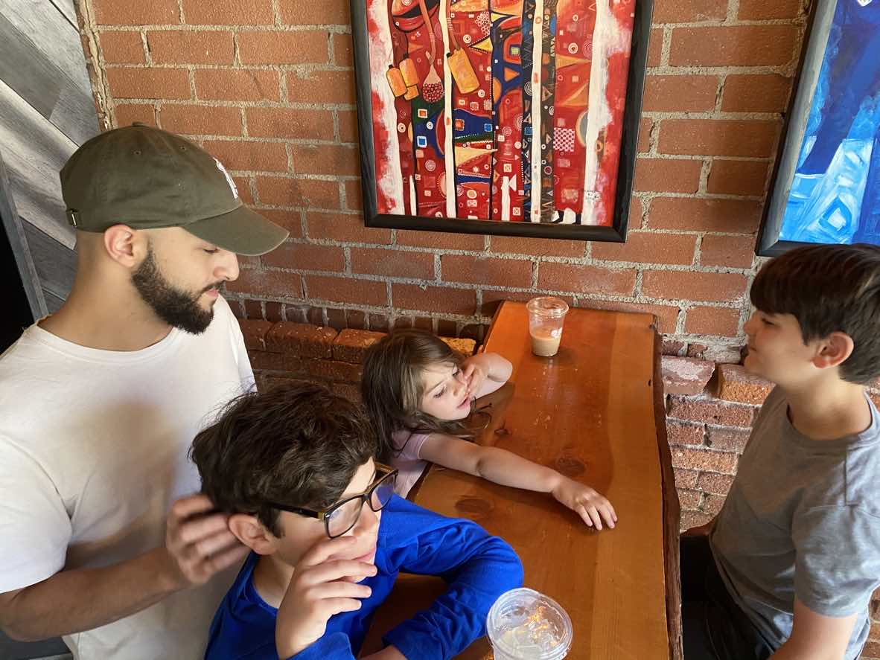
The Saiegs

Slide 45
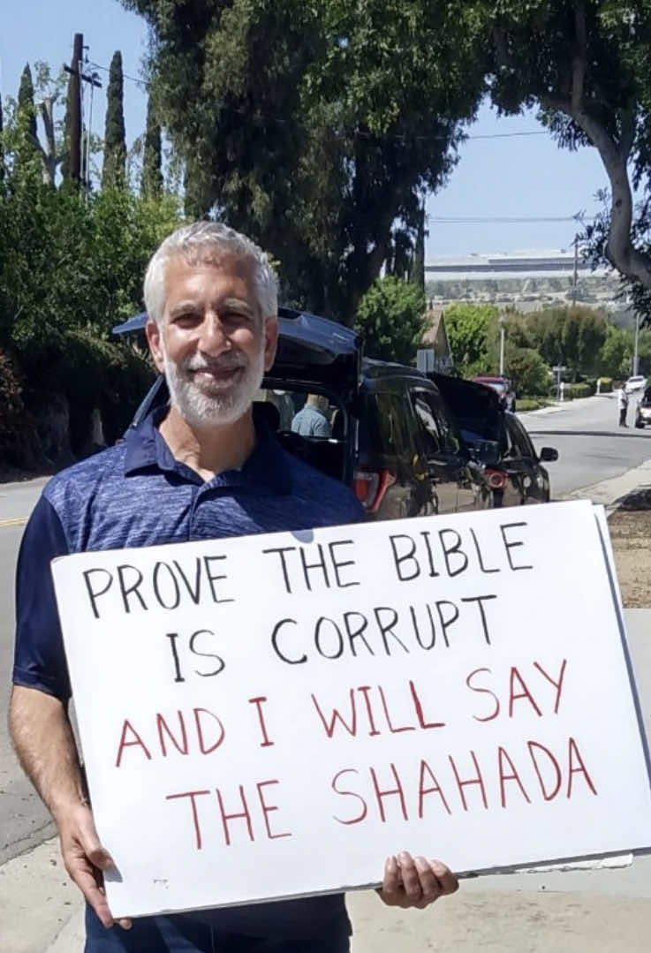

Slide 46
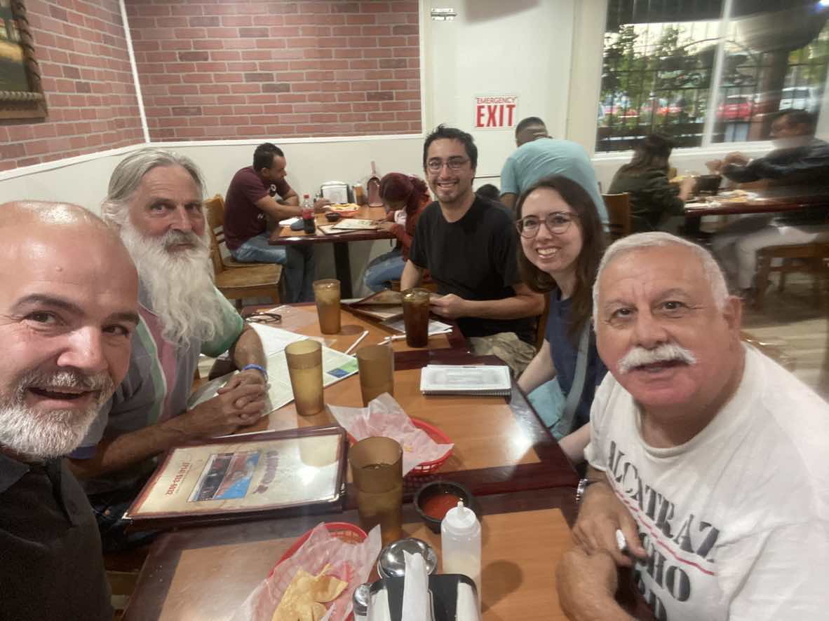

Slide 47
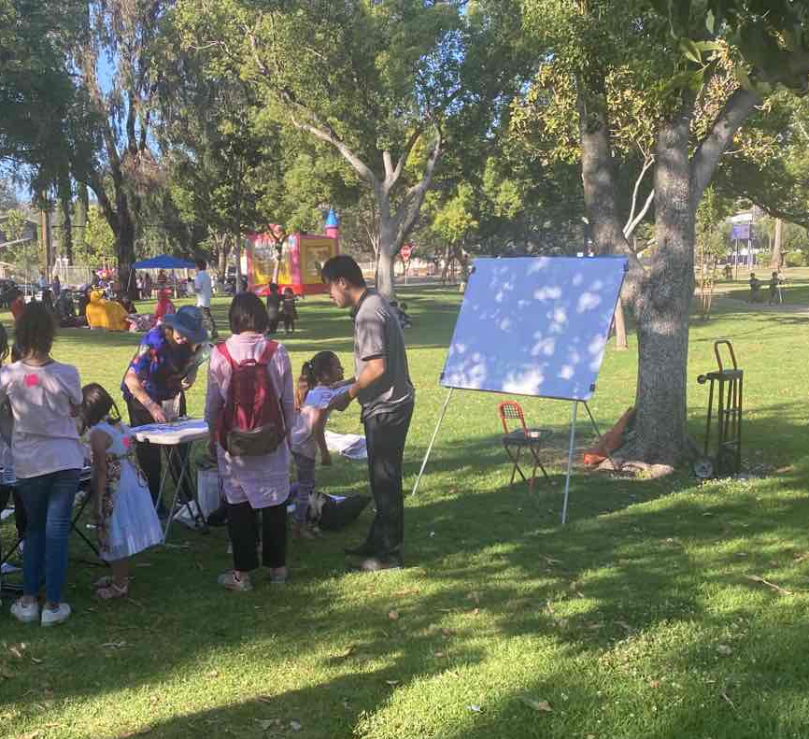

Slide 48
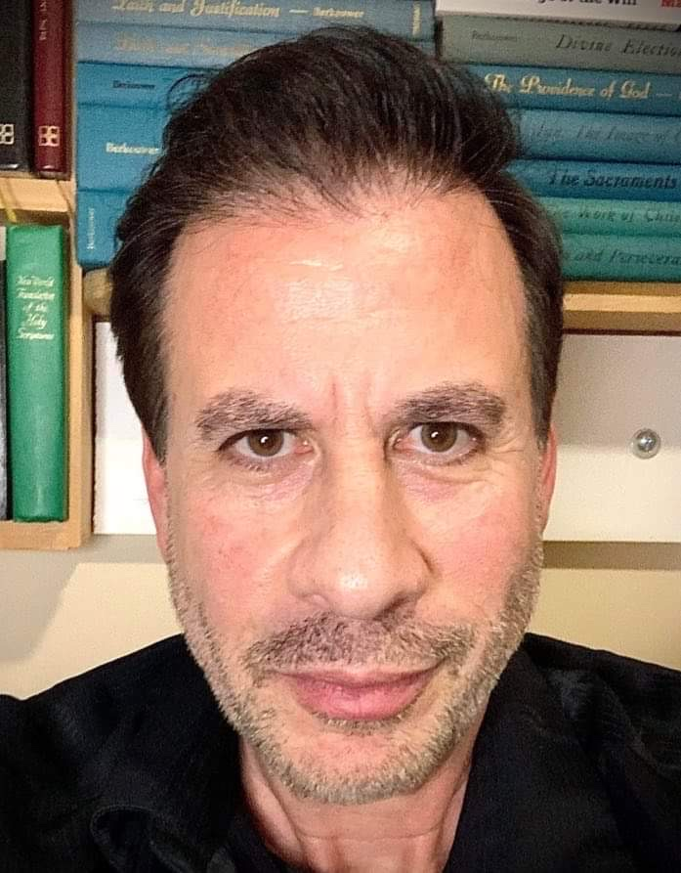
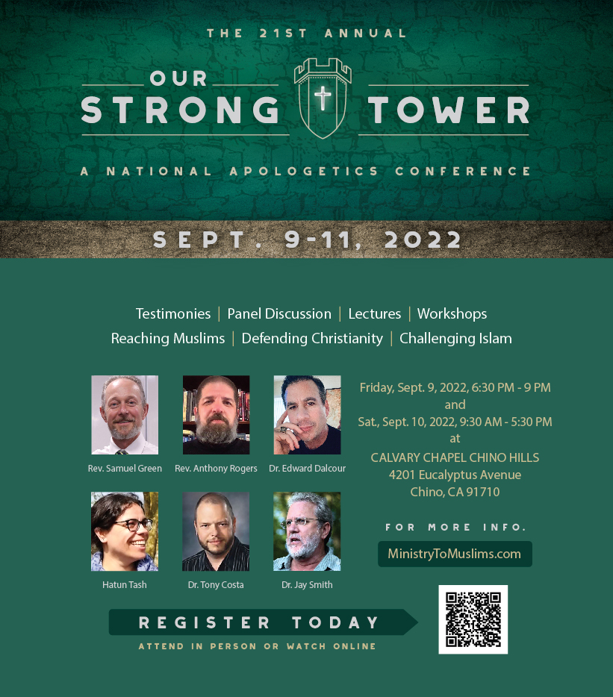

Slide 49
Testimony

